Slide 1

MEDIPRICE ASSISTANT
Guided By : Prof Shailesh Sahu Sir
Group Number : 6
Group Members :
Amruta Kashikar
Srimoyee Dutta
Vaishali Pathania
Aditi Bhardwaj

Slide 2
IDEA DETAILS
An app-based solution that provides details of all the medical facilities and their prices provided by hospitals.
The app will contain the following users :
Users
Hospitals
Admin

Slide 3
USERS INTERFACE
The homepage will consist of a list of types of hospitals and the user can select a type of private hospital (i.e Multispeciality hospitals, Super-speciality hospitals)
If any hospital charges more amount for any medical facility that it provides to the patient then the users can raise a complaint about this to the admin
For viewing the medical facilities or prices of medical facilities the user doesn't have to login into the app.
If any user wants to raise a complaint then the user has to login first into the app then the user can proceed with raising a complaint

Slide 4
HOSPITALS INTERFACE
To avoid any malpractices whenever an account of any hospital is created then the admin first verifies the details of the hospital.
After verification, the hospital can add the medical facilities that are provided there and the prices of the medical facilities.
As the hospital completes entering all the details they will get a pop over to confirm whether the details are correct and then the section of the modification of prices will get locked.
If the hospital wants to do any changes to the pricing it has to send a request to the admin to allow it to make changes.
There will be another section ie. the complaints resolving section where the hospital will be able to see the messages the admin sends to resolve any complaints about that hospital.

Slide 5
ADMIN INTERFACE
The homepage will consist of 3 options :
a) Verification of account
b) Enabling prices modification
c) Complaint management
In the account verification admin has to verify hospital details before approving the hospital to create an account in the app.
Next is enabling the modification of the price by hospitals after hospital requests to enable modification.
After that, the admin will have a complaint management section where the admin can view all the complaints logged by users

Slide 6
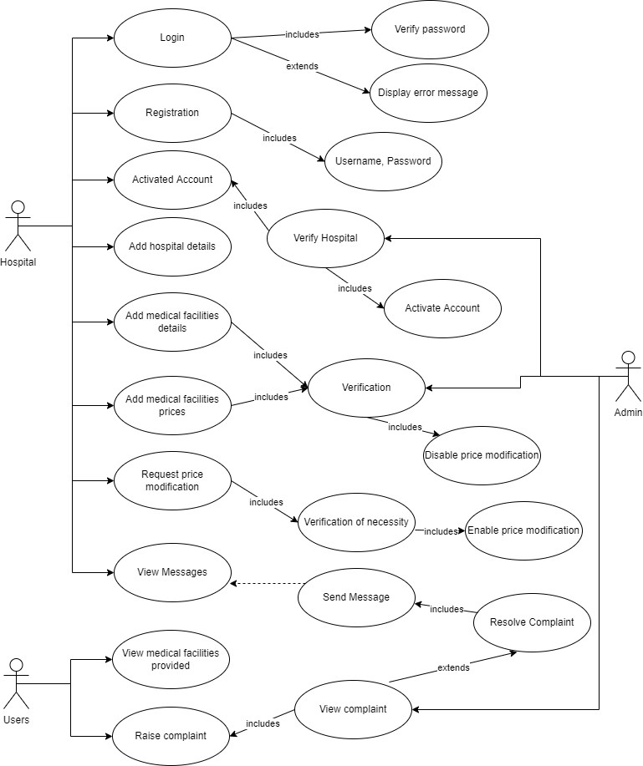
USE CASE DIAGRAM

Slide 7
TECHONOLOGY STACK
Language
Java
Framework
Native Android
Database
Firebase

Slide 8
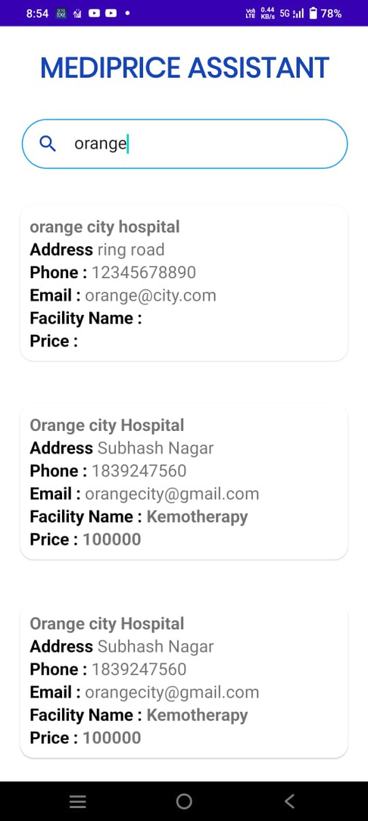
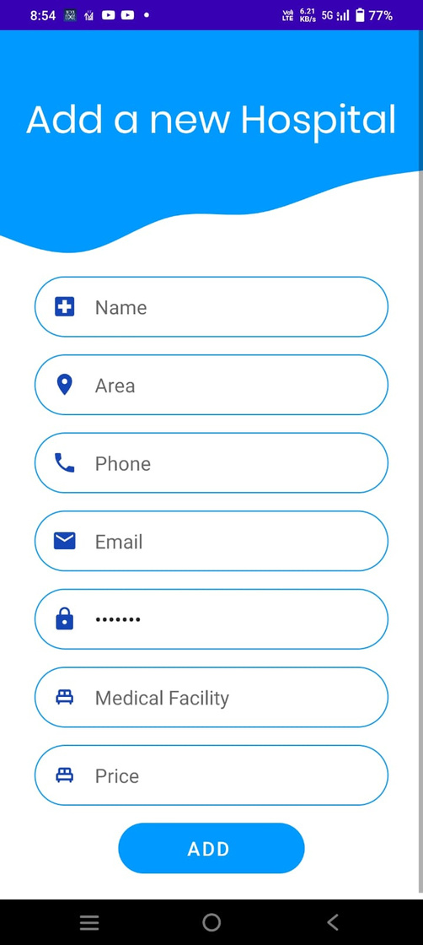

Slide 9
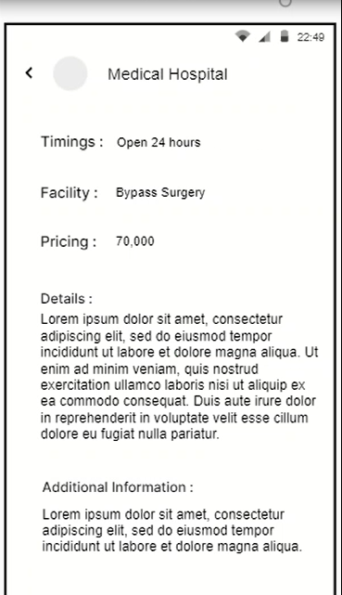
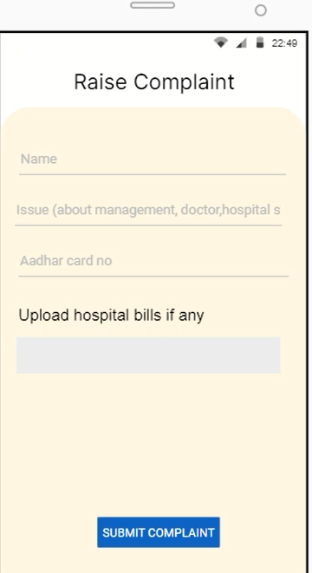

Slide 10
THANK YOU

